Slide 1
AWS Pipeline (CI/CD)
What is AWS CodePipeline?
An AWS CodePipeline for automating software releases (CI/CD) or AWS Data Pipeline for data processing, both creating workflows to move and transform data or code through defined stages (source, build, test, deploy) for consistent, reliable automation, integrating with various AWS and third-party tools.

Slide 2
AWS Pipeline (CI/CD)
AWS CodePipeline (for Software Delivery)
Purpose: Models, visualizes, and automates the steps to release software, ensuring consistent quality checks.
How it Works: Triggers automatically on code changes, moving artifacts through stages like:
Source: Pulls code from repositories (CodeCommit, GitHub).
Build: Compiles code (AWS CodeBuild).
Test: Runs tests.
Deploy: Deploys to environments (CodeDeploy, EC2, ECS).

Slide 3
AWS Pipeline (CI/CD)
AWS CodePipeline (for Software Delivery)
Purpose: Models, visualizes, and automates the steps to release software, ensuring consistent quality checks.
How it Works: Triggers automatically on code changes, moving artifacts through stages like:
Source: Pulls code from repositories (CodeCommit, GitHub).
Build: Compiles code (AWS CodeBuild).
Test: Runs tests.
Deploy: Deploys to environments (CodeDeploy, EC2, ECS). Key Feature: Integrates with other AWS developer tools and third-party services (Jenkins, GitHub) for end-to-end automation.

Slide 4
AWS Pipeline (CI/CD)
AWS CodePipeline (for Software Delivery)
Purpose: Models, visualizes, and automates the steps to release software, ensuring consistent quality checks.
How it Works: Triggers automatically on code changes, moving artifacts through stages like:
Source: Pulls code from repositories (CodeCommit, GitHub).
Build: Compiles code (AWS CodeBuild).
Test: Runs tests.
Deploy: Deploys to environments (CodeDeploy, EC2, ECS). Key Feature: Integrates with other AWS developer tools and third-party services (Jenkins, GitHub) for end-to-end automation.

Slide 5
AWS Pipeline (CI/CD)
CICD pipeline overview
AWS brings in a complete set of CI/CD developer tools to accelerate software development and release cycles. AWS CodePipeline automates the build, test, and deploy phases of the release process every time there is a code change, based on the defined release model. This enables the rapid and reliable delivery of features and updates.

Slide 6
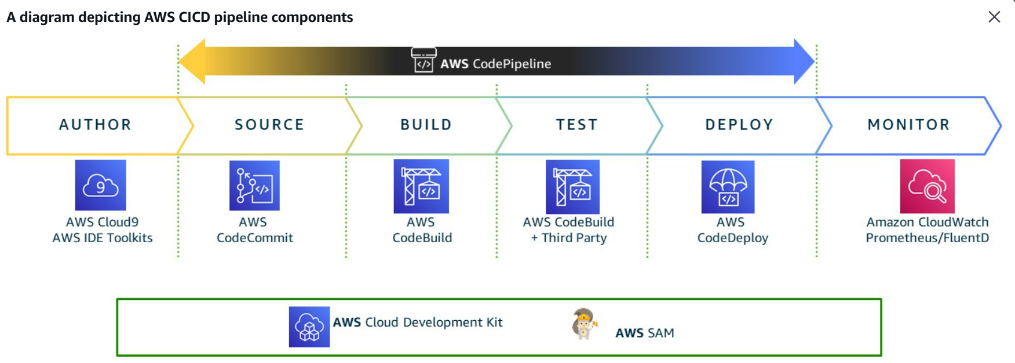
AWS Pipeline (CI/CD)
CICD pipeline overview

Slide 7
AWS Pipeline (CI/CD)
buildspec.yml and appspec.yml
In an AWS CI/CD pipeline, buildspec and appspec are configuration files that tell different AWS services exactly how to handle your code during the build and deployment phases. 1. Buildspec (buildspec.yml) The Buildspec file is used by AWS CodeBuild. It contains the set of instructions that CodeBuild uses to compile your code, run tests, and package your application into a deployable format (an "artifact").

Slide 8
AWS Pipeline (CI/CD)
buildspec.yml and appspec.yml
Location: Must be in the root directory of your source code.
Key Phases:
Install: Used to install dependencies (e.g., npm install or pip install).
Pre-build: Commands to run before the main build, such as logging into Amazon ECR.
Build: The actual compilation or packaging commands (e.g., mvn package or docker build).
Post-build: Final cleanup, tagging, or pushing artifacts to S3 or ECR.
Artifacts: This section tells CodeBuild which files to save and pass on to the deployment stage.

Slide 9
AWS Pipeline (CI/CD)
buildspec.yml and appspec.yml
2. AppSpec (appspec.yml) The AppSpec (Application Specification) file is used by AWS CodeDeploy. It defines how the application should be installed on your target servers (EC2, Lambda, or ECS) and what scripts to run at various points during the deployment.

Slide 10
AWS Pipeline (CI/CD)
buildspec.yml and appspec.yml
Location: Must be in the root directory of your deployment package.
Key Sections:
Files: Maps files from your build artifact to specific folders on the target server.
Permissions: Sets ownership and permissions for the copied files (Linux only).
Hooks: A series of lifecycle events (like AfterInstall) where you can run custom scripts.

Slide 11
AWS Pipeline (CI/CD)
buildspec.yml and appspec.yml
3. AfterInstall (Lifecycle Hook)
AfterInstall is a specific "hook" or event inside the appspec.yml file. It is used to run tasks immediately after the application files have been copied to the destination folder but before the application is started.
Common Uses:
Changing file permissions or ownership.
Running configuration scripts or environment setup.
Decrypting sensitive files or secret keys.
Timing: It runs after the Install event (where files are copied) and before ApplicationStart.

Slide 12
AWS Pipeline (CI/CD)
Comparison Summary
buildspec.yml and appspec.yml
Comparison Summary
Feature | Buildspec | AppSpec
AWS Service | AWS CodeBuild | AWS CodeDeploy
Purpose | Compiling and packaging code | Deploying and configuring the app
Stage | Build Stage of the pipeline | Deploy Stage of the pipeline
Example Hook | pre_build, build | BeforeInstall, AfterInstall, ApplicationStart

Slide 13
AWS Pipeline (CI/CD)
buildspec.yml and appspec.yml
Example: Minimal Build File This file simply installs dependencies and prepares the files for deployment. version: 0.2
phases:
install:
commands:
- npm install
build:
commands:
- npm run build
artifacts:
files:
- '**/*'
base-directory: 'dist'

Slide 14
AWS Pipeline (CI/CD)
buildspec.yml and appspec.yml
What this small file does: version: 0.2: Tells AWS to use the standard build engine.
install: Runs npm install to download your project libraries.
build: Runs your build script (like compiling code or minifying CSS).
artifacts: Takes everything inside the dist folder and hands it over to the next step in your pipeline (like CodeDeploy).

Slide 15
AWS Pipeline (CI/CD)
buildspec.yml and appspec.yml
What this small file does: version: 0.2: Tells AWS to use the standard build engine.
install: Runs npm install to download your project libraries.
build: Runs your build script (like compiling code or minifying CSS).
artifacts: Takes everything inside the dist folder and hands it over to the next step in your pipeline (like CodeDeploy).

Slide 16
AWS Pipeline (CI/CD)
buildspec.yml and appspec.yml
appsec.yml An AppSpec (Application Specification) file is a configuration file used by AWS CodeDeploy to manage a deployment. It defines how the application should be installed and what scripts should run at different stages of the deployment.
For EC2/On-Premises deployments, this file must be named appspec.yml and placed in the root directory of your application's source code.

Slide 17
AWS Pipeline (CI/CD)
buildspec.yml and appspec.yml
appsec.yml This "bare-bones" example copies all files from your project to a specific folder on a Linux server and runs one script after installation.
version: 0.0
os: linux
files:
- source: /
destination: /var/www/html
hooks:
AfterInstall:
- location: scripts/install_dependencies.sh
timeout: 300
runas: root

Slide 18
AWS Pipeline (CI/CD)
buildspec.yml and appspec.yml
appsec.yml Detailed Breakdown of Sections
1. Version (version: 0.0)
This specifies the AppSpec file format version.
Important: Currently, the only allowed value is 0.0.
2. Operating System (os)
Specifies the OS of your target instance.
Values: linux or windows.
3. Files (files)
This section tells CodeDeploy which files to copy from your "artifact" (from the build stage) to the server.
source: The path to files in your build artifact. A single slash (/) means "everything".
destination: The folder on your target server where those files should be placed.

Slide 19
AWS Pipeline (CI/CD)
buildspec.yml and appspec.yml
appsec.yml 4. Hooks (hooks)
Hooks are "lifecycle events" that trigger specific scripts during the deployment.
AfterInstall: This hook is commonly used to run setup scripts (like npm install on the server) immediately after the files are copied.
location: The path to the script inside your project.
timeout: How long (in seconds) CodeDeploy should wait for the script to finish before failing the deployment. runas: The user account on the server that should execute the script (e.g., root, ubuntu, or ec2-user).

Slide 20
AWS Pipeline (CI/CD)
buildspec.yml and appspec.yml
appsec.yml Key Common Hooks
BeforeInstall: Used for tasks like decrypting files or deleting old files before the new ones arrive.
AfterInstall: Used for configuration tasks or installing additional server-side dependencies.
ApplicationStart: Used to start the web server or application (e.g., service apache2 start).
ValidateService: The final step to verify that the application is running correctly (e.g., by checking if a local URL returns a 200 OK status).

Slide 21
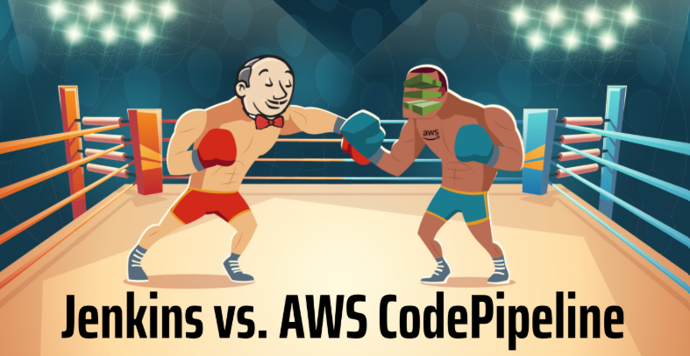
AWS Pipeline (CI/CD)
Jenkins vs AWS Pipeline

Slide 22
AWS Pipeline (CI/CD)
Jenkins vs AWS Pipeline
Jenkins
Type: Open-source CI/CD tool
Hosting: Self-hosted (on-prem, EC2, containers)
Setup & Maintenance: Manual setup, upgrades, scaling, security
Flexibility: Very high (thousands of plugins)
Customization: Extensive (custom scripts, plugins, pipelines)
Integration: Works with almost any tool/platform
Cost: Free (but infra + maintenance cost)

Slide 23
AWS Pipeline (CI/CD)
Jenkins vs AWS Pipeline
AWS CodePipeline
Type: Fully managed CI/CD service
Hosting: Managed by AWS
Setup & Maintenance: Minimal (AWS handles infra, scaling)
Flexibility: Moderate (AWS-centric)
Customization: Limited compared to Jenkins
Integration: Native with AWS services (CodeBuild, CodeDeploy, S3, Lambda)
Cost: Pay-as-you-go per pipeline
Scalability: Automatic

Slide 24
AWS Pipeline (CI/CD)
Jenkins vs AWS Pipeline
AWS CodePipeline
Type: Fully managed CI/CD service
Hosting: Managed by AWS
Setup & Maintenance: Minimal (AWS handles infra, scaling)
Flexibility: Moderate (AWS-centric)
Customization: Limited compared to Jenkins
Integration: Native with AWS services (CodeBuild, CodeDeploy, S3, Lambda)
Cost: Pay-as-you-go per pipeline
Scalability: Automatic

Slide 25
AWS Pipeline (CI/CD)
Jenkins vs AWS Pipeline
Quick Summary
Choose Jenkins → if you need maximum control, custom workflows, or multi-cloud/on-prem support
Choose AWS CodePipeline → if you want low-maintenance, AWS-native CI/CD

